Slide 1
Salient Object Detection by Composition
Jie Feng¹, Yichen Wei², Litian Tao³, Chao Zhang¹, Jian Sun²
¹Key Laboratory of Machine Perception, Peking University
²Microsoft Research Asia
³Microsoft Search Technology Center Asia

Slide 2
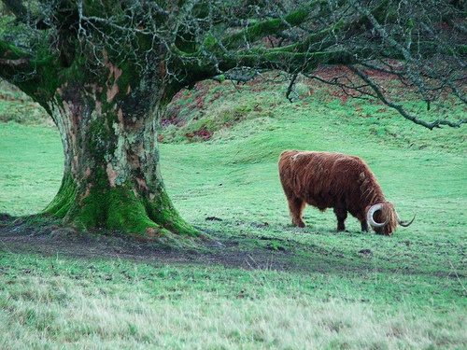
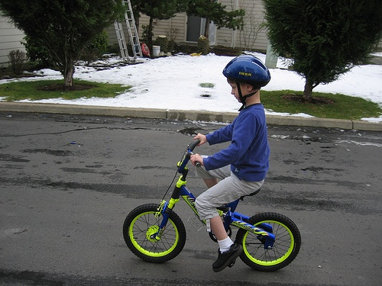
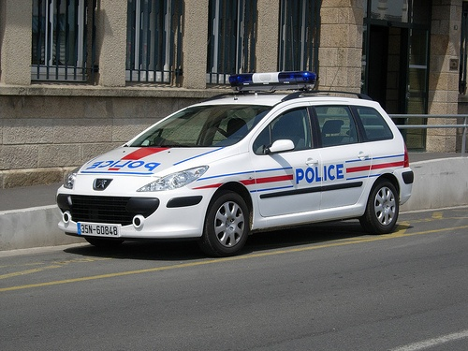
A key vision problem: object detection
Fundamental for image understanding
Extremely challenging
Huge number of object classes
Huge variations in object appearances

Slide 3
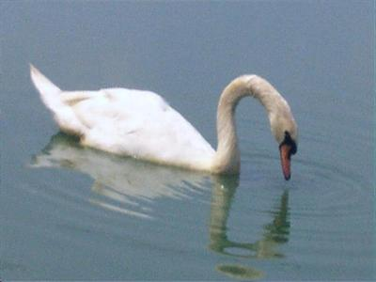
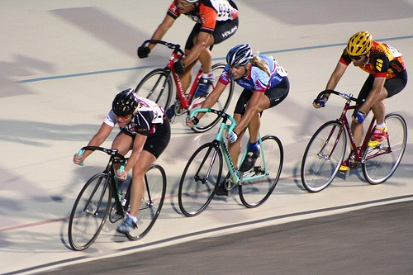
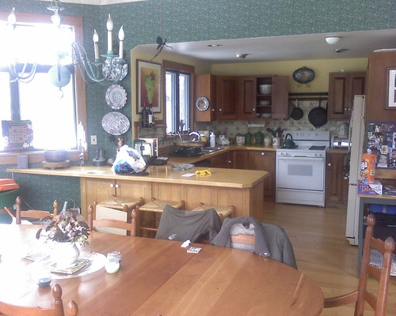
What are salient objects?
Visually distinctive and semantically meaningful
Inherently ambiguous and subjective
Yes!
Yes? probably
No!
Notes:
It’s not easy to define what is a salient object. Conceptually, a salient object is …. This definition is still very ambiguous. Let’s look at a few examples.

Slide 4
Why detect salient objects?
Relatively easy: large and distinct
Semantically important
Image summarization, cropping…
Object level matching, retrieval…
A generic object detector for later recognition
avoid running thousands of different detectors
a scalable system for image understanding
Notes:
It’s relatively easy to find salient objects than other ones because they are …

Slide 5
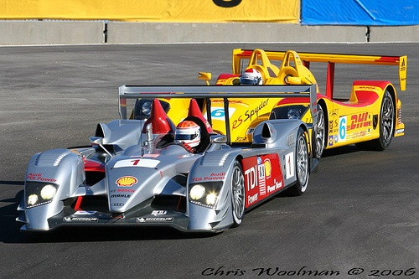
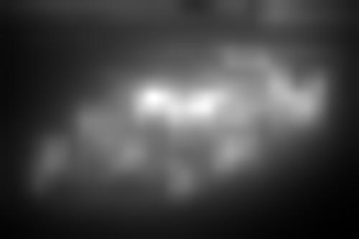

Traditional approach: saliency map
Measures per-pixel importance
Loses information and deficient to find objects

Slide 6
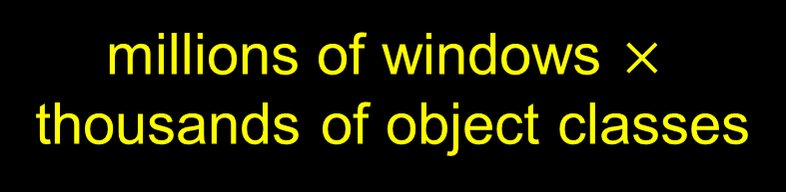
sliding window object detection
Face, human…
Car, bus…
Horse, dog…
Table, couch…
…
millions of windows $×$
thousands of object classes
Slide different size windows over all positions
Evaluate a quality function, e.g., a car classifier
Output windows those are locally optimum

Slide 7
Salient object detection by composition
A ‘composition’ based window saliency measure
intuitive and generalizes to different objects
A sliding window based generic object detector
fast and practical: 1-2 seconds per image
a few dozens/hundreds output windows
Effective pre-processing for later recognition tasks

Slide 8
It is hard to represent a salient window
Given image I and window W
saliency(W) = cost of composing W using (I-W)

Slide 9
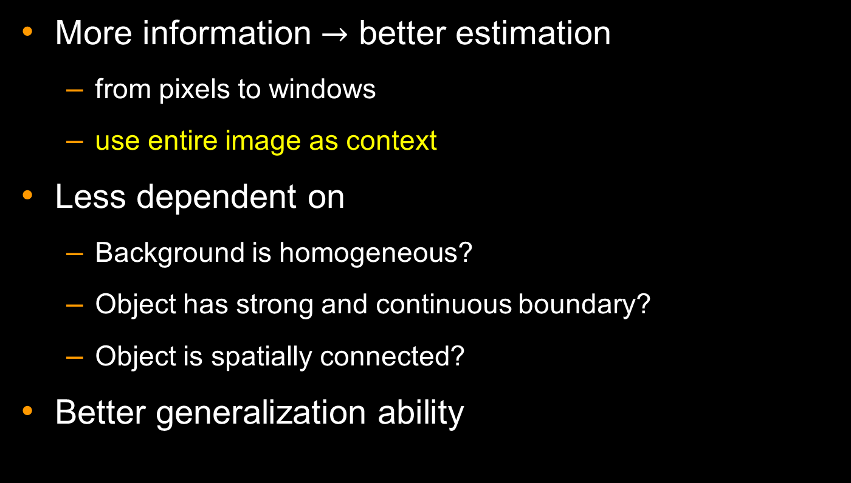
Benefits of ‘composition’ definition
More information $→$ better estimation
from pixels to windows
use entire image as context
Less dependent on
Background is homogeneous?
Object has strong and continuous boundary?
Object is spatially connected?
Better generalization ability

Slide 10
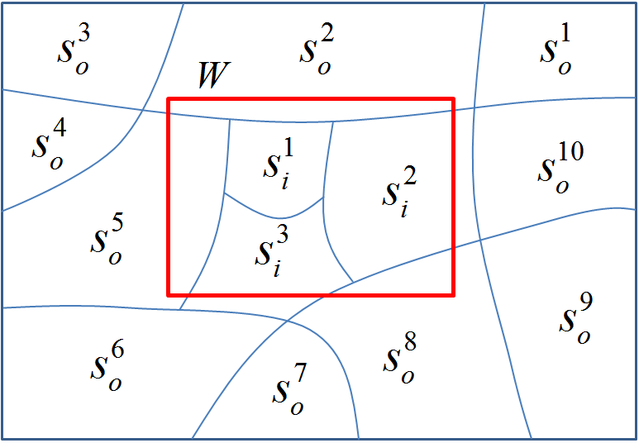
Part based representation
Each part S has an (inside/outside) area A(S)
Each part pair (p, q) has a composition cost c(p, q)

Slide 11
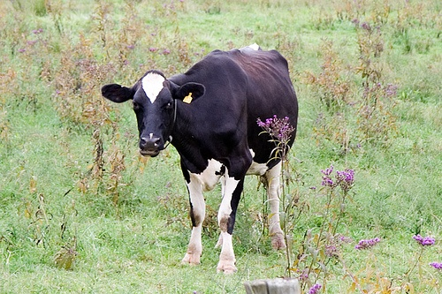
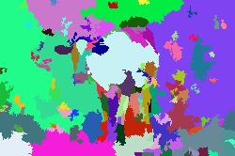
Generate parts by over-segmentation
Typically 100-200 segments in a natural image
P.F.Felzenszwalb and D.P.Huttenlocher. Efficient graph-based image segmentation. IJCV, 2004

Slide 12
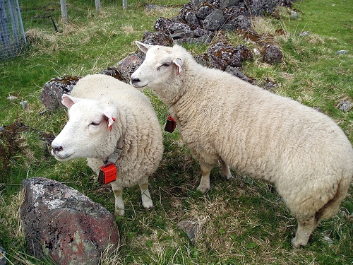
An illustrative ‘composition’ example
W={A, B, C
D, E}
a
c
C
saliency(W)=
cost(A,a)
+cost(B,b)
+cost(C,c)
+cost(D,d)
+cost(E,e)
A
b
B
d
D
e
E

Slide 13
Computational principles
Appearance proximity
Spatial proximity
Non-reusability
Non-scale-bias
Intuitive perceptions about saliency

Slide 14
1. Appearance proximity
c(p, q₁)=0.6
q₁
c(p, q₂)=0.2
p
q₂
Salient parts have distinct appearances
q₁ and q₂ are equally distant from p, q₂ is more similar

Slide 15
2. Spatial proximity
c(p, q₂)=0.2
p
q₂
q₁
c(p, q₁)=0.3
Salient parts are far from similar parts
q₁ and q₂ are equally similar as p, q₂ is closer

Slide 16
3. Non-reusability
An outside part can be used only once
Robust to background clutters

Slide 17
4. Non-scale-bias
0.3
0.6
Normalized by window area and avoid large window bias
tight bounding box > loose one

Slide 18
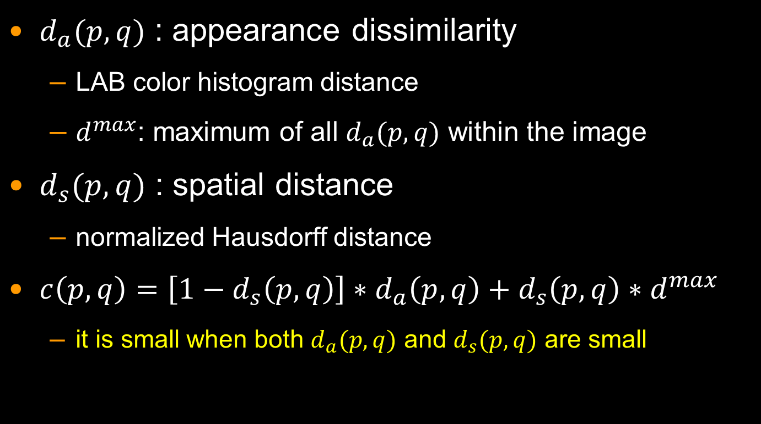
Define composition cost c(p, q)
$d_{a}(p,q)$ : appearance dissimilarity
LAB color histogram distance
$d_{}^{max}$: maximum of all $d_{a}(p,q)$ within the image
$d_{s}(p, q)$ : spatial distance
normalized Hausdorff distance
$c\left(p,q\right)=\left[1−d_{s}\left(p,q\right)\right]∗d_{a}\left(p,q\right)+d_{s}\left(p,q\right)∗d_{}^{max}$
it is small when both $d_{a}(p,q)$ and $d_{s}(p, q)$ are small

Slide 19
Part based composition
Finding outside parts with the same area of inside parts and smallest composition cost
Need to find which outside part to compose which inside part with how much area
Formulated as an Earth Mover’s Distance (EMD)
optimal solution has polynomial (cubic) complexity
A greedy optimization
pre-computation + incremental sliding window update

Slide 20

Greedy composition algorithm
Input: window $W$, inside/outside segments $\left\{S_{i}\right\}/\left\{S_{o}\right\}$ and their initial areas $A(S_{i/o})$
Output: cost $C$ of composing $\left\{S_{i}\right\}$ using $\left\{S_{o}\right\}$
for each $p∈\{S_{i}\}$
for each $q∈\{S_{o}\}$ (in ascending order of $c\left(p,q\right)$)
if $p$ still has area left
update areas in $A\left(p\right)$, $A\left(q\right)$ that are composed
$C=C+c\left(p,q\right)∗composed area$
$C=C/|W|$

Slide 21
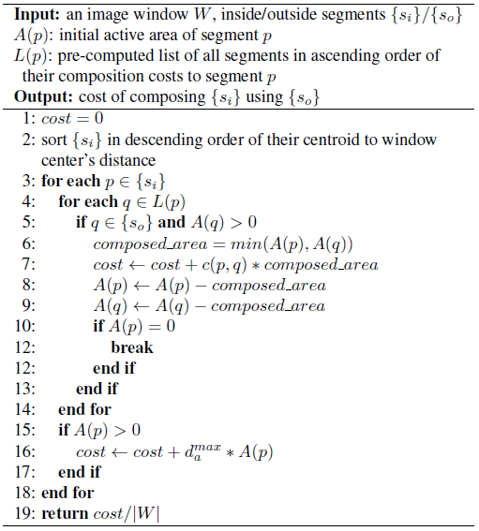
Algorithm pseudo code

Slide 22
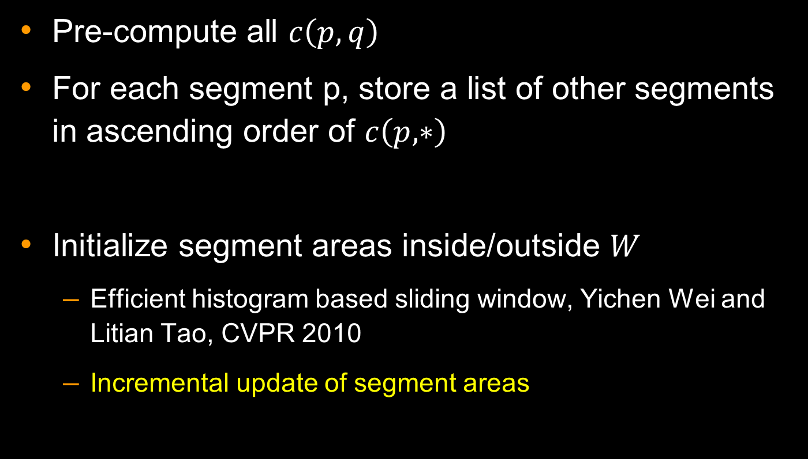
Pre-computation and initialization
Pre-compute all $c\left(p,q\right)$
For each segment p, store a list of other segments in ascending order of $c\left(p, ∗\right)$
Initialize segment areas inside/outside $W$
Efficient histogram based sliding window, Yichen Wei and Litian Tao, CVPR 2010
Incremental update of segment areas

Slide 23
More implementation details
6 window sizes: 2% to 50% of image area
7 aspect ratios: 1:2 to 2:1
100-200 segments
1-2 seconds for 300 by 300 image
Find local optimal windows by non-maximum suppression

Slide 24
Evaluation on PASCAL VOC 07
it’s for object detection
20 object classes
Large object and background variation
Challenging for traditional saliency methods
not totally suitable for salient object detection
Not all labeled objects are salient: small, occluded, repetitive
Not all salient objects are labeled: only 20 classes
but still the best database we have

Slide 25
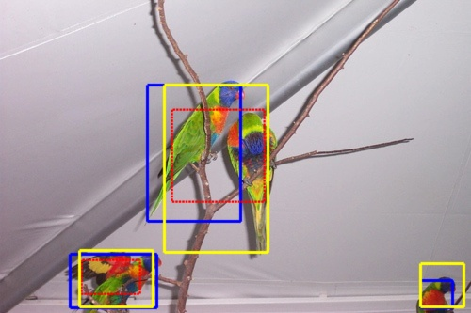
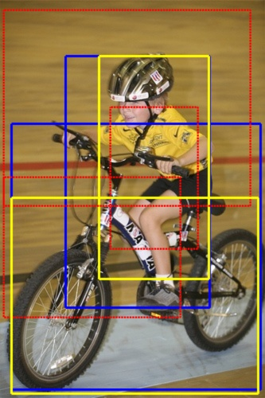
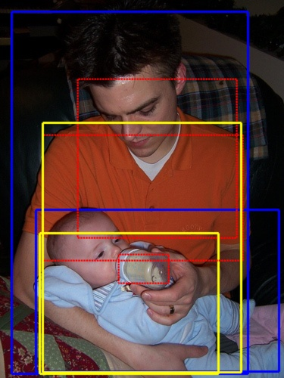
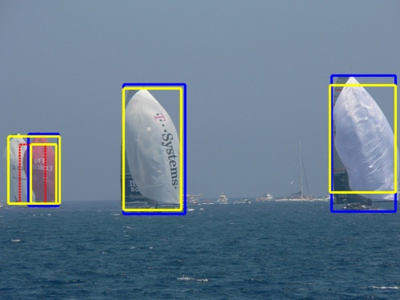
Yellow: correct, Red: wrong, Blue: ground truth
top 5 salient windows

Slide 26
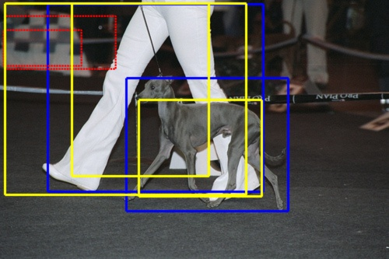
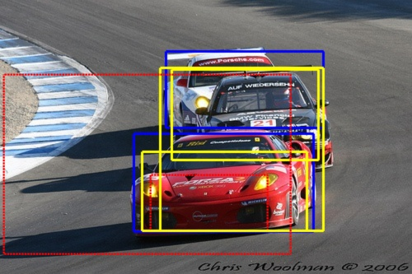
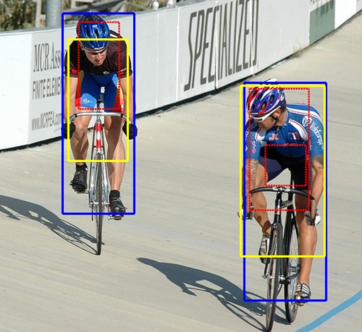
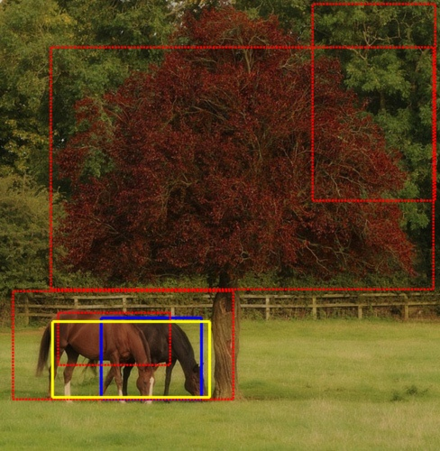
Yellow: correct, Red: wrong, Blue: ground truth

Slide 27
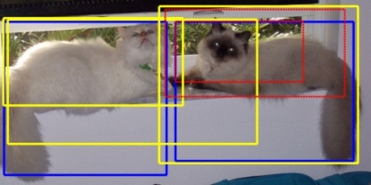
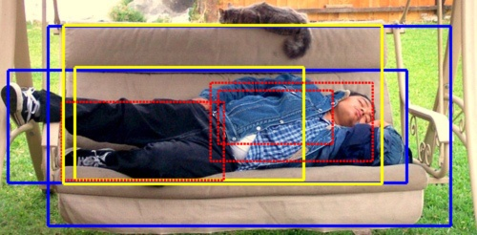
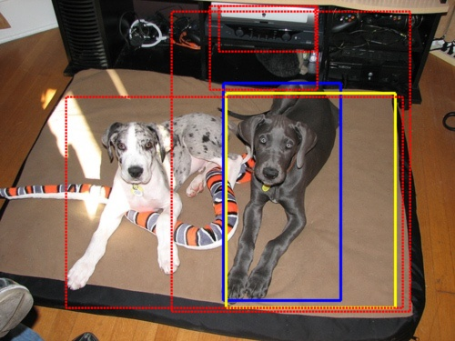
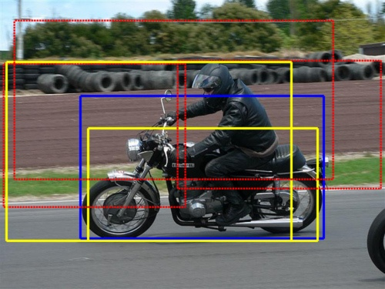
Yellow: correct, Red: wrong, Blue: ground truth

Slide 28
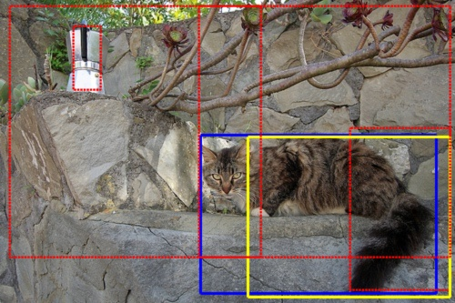
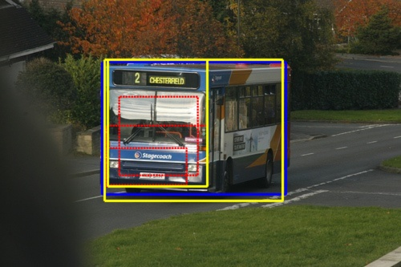
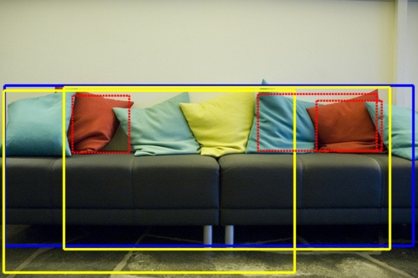
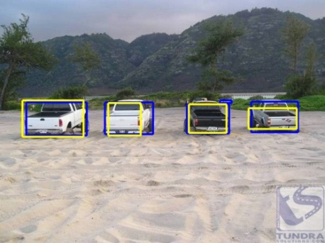
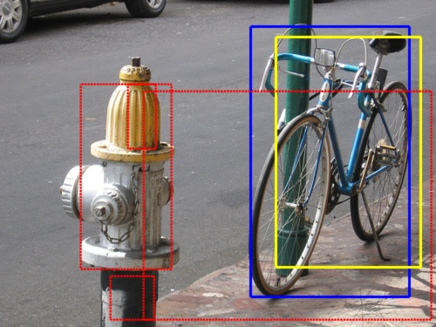
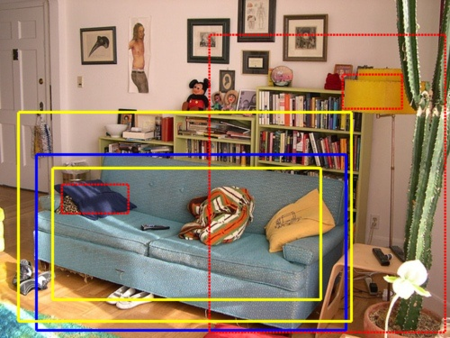
Yellow: correct, Red: wrong, Blue: ground truth

Slide 29
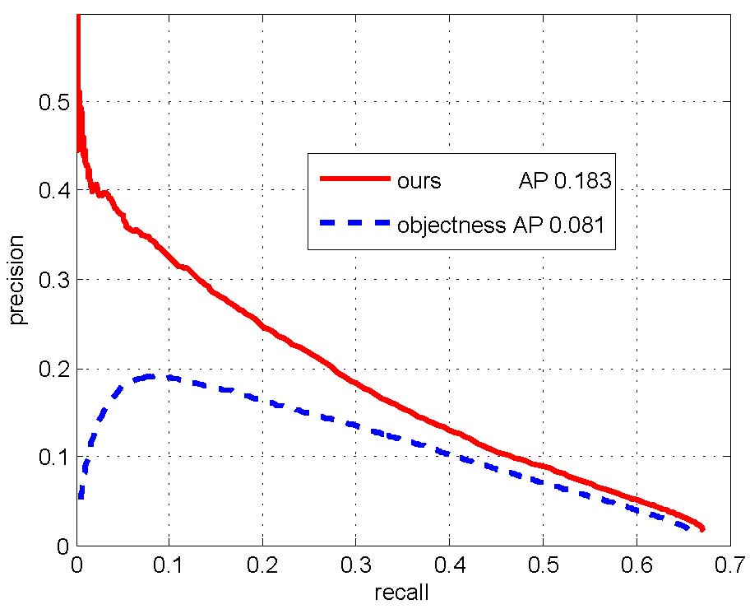
Outperforms the state-of-the-art
Objectness: B.Alexe, T.Deselaers, and V.Ferrari. What is an object. In CVPR, 2010.
Uses mainly local cues: find locally salient windows that are globally not

Slide 30
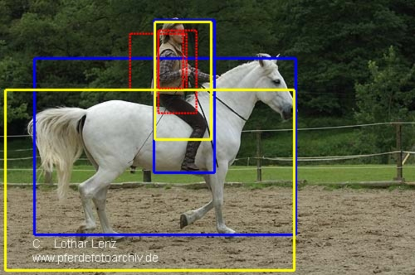
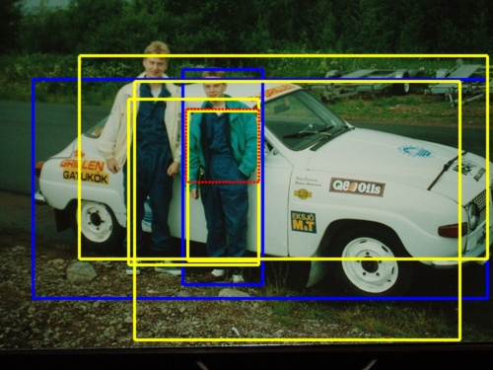
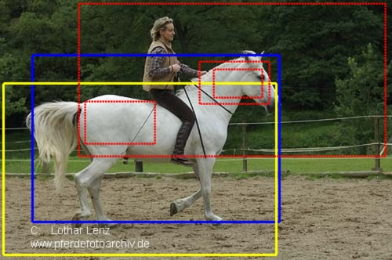
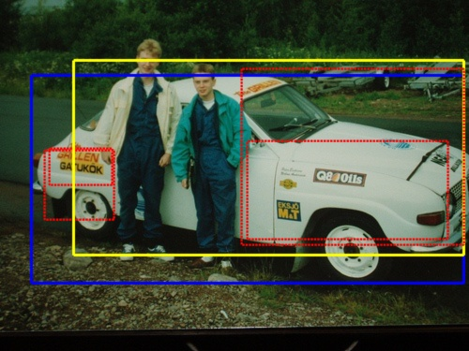
Yellow: correct, Red: wrong, Blue: ground truth
ours
objectness

Slide 31
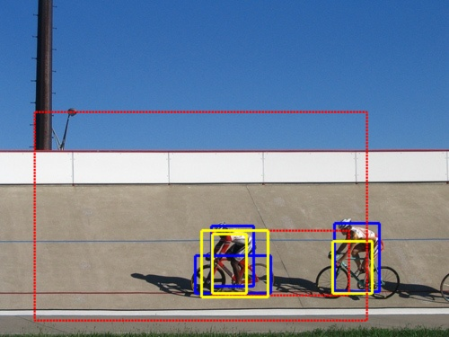
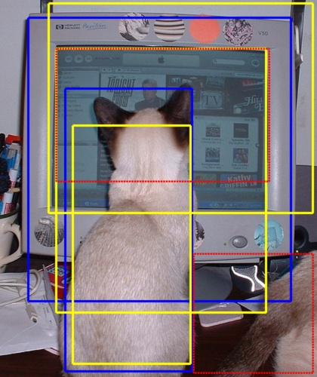
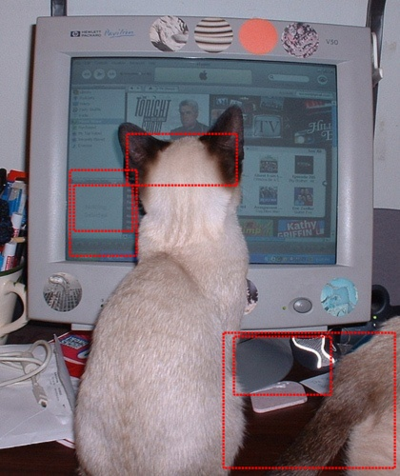
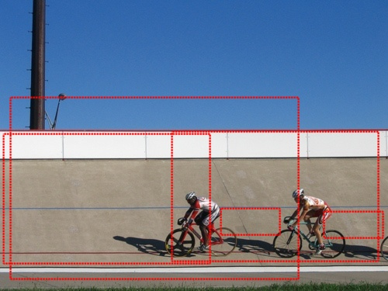
Yellow: correct, Red: wrong, Blue: ground truth
ours
ours
objectness
objectness

Slide 32
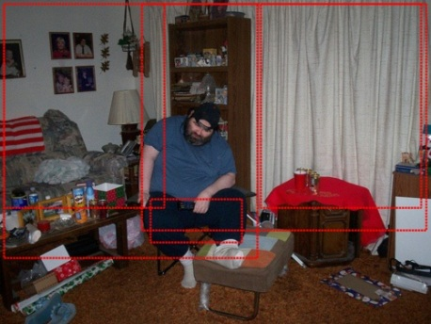
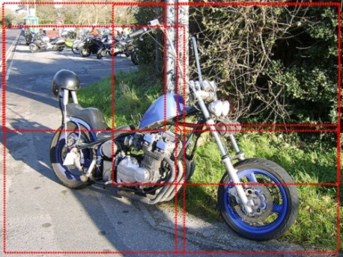
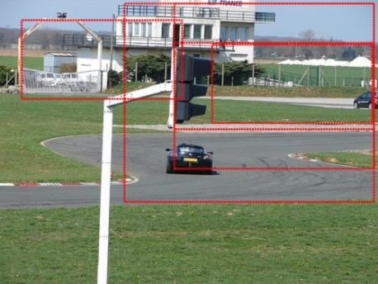
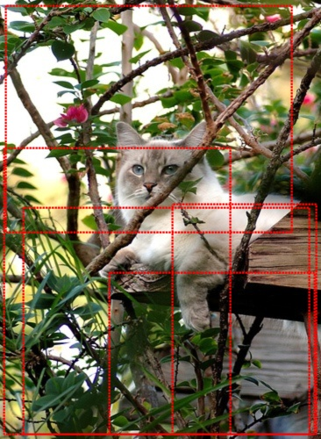
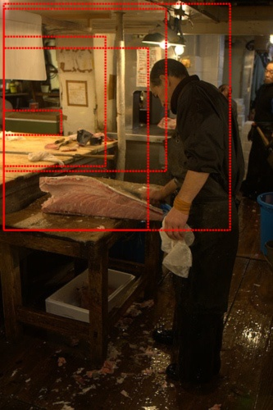
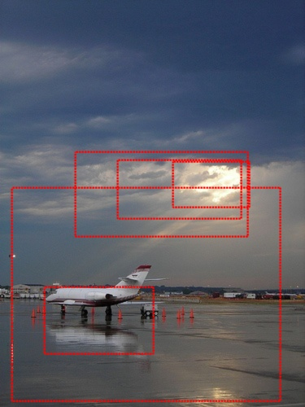
Failure cases: too complex

Slide 33






Failure cases: lack of semantics
Partial background with object: man with background
Not annotated objects: painting, pillows
Similar objects together: two chairs

Slide 34






Failure cases: lack of semantics
Partial object or object parts: wheels and seat

Slide 35
#windows V.S. detection rate
#top windows | 5 | 10 | 20 | 30 | 50
recall | 0.25 | 0.33 | 0.44 | 0.5 | 0.57
Find many objects within a few windows
A practical pre-processing tool

Slide 36
Evaluation on MSRA database
Less challenging: only a single large object
T.Liu, J.Sun, N.Zheng, X.Tang, and H.Shum. Learning to detect a salient object. In CVPR, 2007
Use the most salient window of our approach in evaluation
pixel level precision/recall is comparable with previous methods
Our approach is principled for multi-object detection
benefits less from the database’s simplicity than previous methods

Slide 37

Summary
A novel ‘composition’ based saliency measure
pixel saliency $→$ window saliency
a saliency map $→$ a generic (salient) object detector
State-of-the-art accuracy and performance
Future work
better feature/composition algorithm
learning a discriminative generic object classifier

